Slide 1

CRNOGORSKI KOMITET MEĐUNARODNOG VIJEĆA
ZA VELIKE ELEKTRIČNE MREŽE - CIGRE
Milutin Ostojić
Milorad Samardžić
Radinko Kostić
MAGNETSKO POLJE BIPOLARNOG HVDC KABLA ITALIJA-CRNA GORA
NA PODVODNOJ I KOPNENOJ DIONICI
Herceg Novi – Igalo 11-14 maj 2015.

Slide 2
± 500 kV HVDC Italy -Montenegro electric power systems connection route

Slide 3
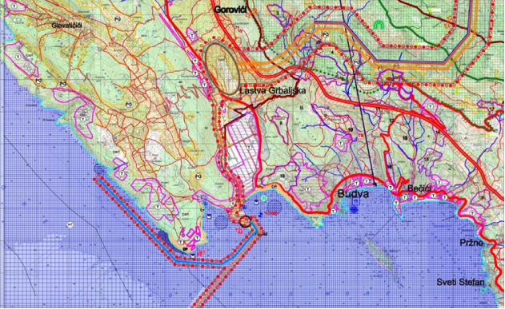
Route ±500kV submarine HVDC/underground cable Italy-Montenegro, Montenegrin part

Slide 4
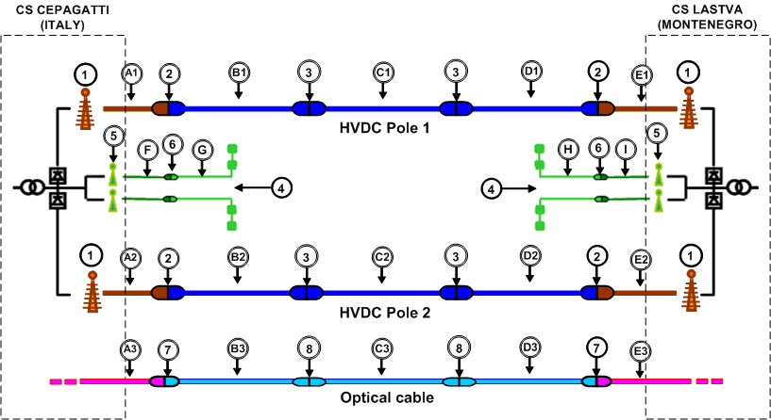
± 500 kV HVDC cable connection Italy - Montenegro, principled scheme
Legend:
Connection of a HVDC pole underground cable to converter
station by means of 500 kV termination,
2. Sea/land joint for submarine and underground cable 500 kV,
3. Joint pieces/parts for submarine cable 500 kV,
4. Submarine electrodes with the appropriate MV cables,
5. Connection of an underground electrode cable to converter station by
means of MV termination,
6. Joint between submarine and underground electrode cables.

Slide 5
For the realization of 1000 MW voltage interconnection, the following cables were chosen:
- Submarine HVDC cable with Aluminum conductor (Al) and insulation type MIND with cross-section of 1900 mm² for rated current 1200 A
- Underground HVDC cable with Copper conductor (Cu) and insulation type MIND, with cross-section of 1900 mm² for rated current 1200 A.
Connection of mutual ends of submarine and underground cables during their transition from sea to land, is performed by means of special joints in chamber which is located in the coastal part of the mainland, with approximate dimensions 20x5,5x1,5 m.

Slide 6
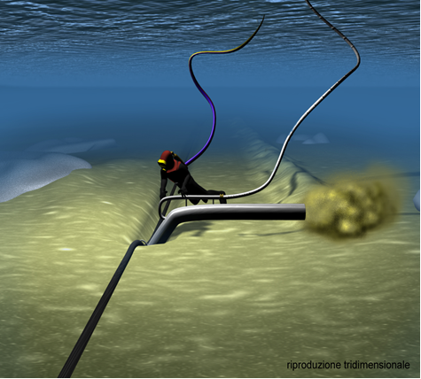
Jetting" technology for cable protection
Jetting" technologyfor cable protection
Cement mattresses during handling and sketch of mattresses
laid on cable pipe

Slide 7
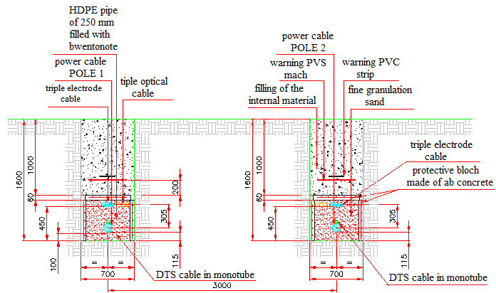
Underground cables are laid in two parallel cable trenches at the mutual distance of about 3 meters, and lead to the converter station where they are connected via the appropriate cable terminations.

Slide 8
Electrodes and electrode cables
MV underground electrode cables are laid on the mainland in the same trench in which HDVC cables are laid, up to the cable chamber in which is performed the connection of the underground and submarine cables. After the entrance into the sea, MV electrode cables are laid in a separate route in the seabed, and are led to the electrode to which they are connected. Electrode on Montenegrin side is planned to be north from Cape Platamuni, in the north-west from the Cape Jaz.
Route of the electrode cable is parallel to the route of submarine cables on the sea entering point, and then turns west toward Cape Platamuni, continuing north to the electrode location. Minimum distance between electrode cable and Cape Jaz is 120 m, electrode cable and the beach Trstenovo around 2.000 m, and electrode cable and peninsula Platamuni 127 m. The average sea depth on the electrode cable route ranges from 30 to 50 m.

Slide 9
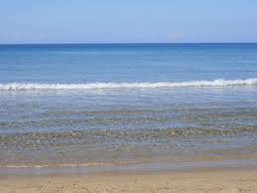

Electrodes and Installation of Electrodes
Underwater electrode system for this project enables monopolar operation of HVDC transmission system, i.e. that only one of the terminals is in function, and that a return current closes via submarine electrodes. Electrode system is "bi-directional", which means that allows current flow in both directions.
Electrode Features: Each electrode is made of two sub-electrodes. Each sub-electrode contains 6 support structures for dispersion elements, with the dimensions of 9 x 11,5 m, i.e. there is a total of 12 support structures per each bi-directional electrode.
Elements are located at 3 m distance, while two sub-electrodes are at approx. 50 m distance . A total length of the electrode is 215 m.

Slide 10
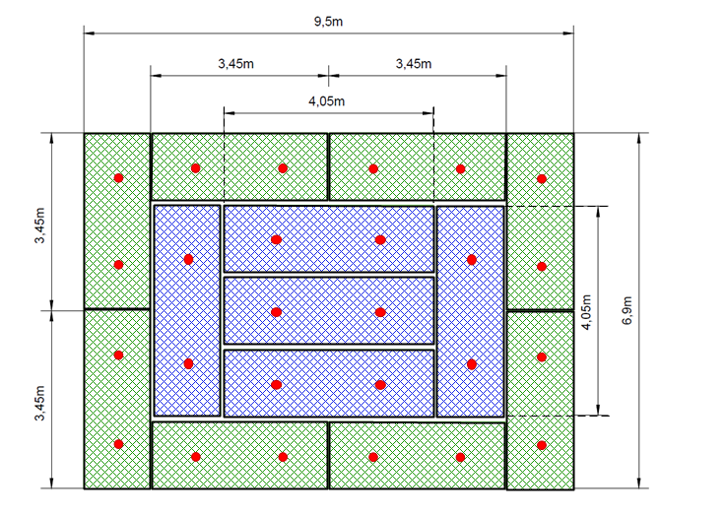
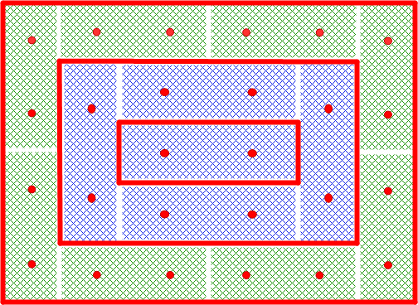
Figure shows the positions of titanium nets in the 6,9 x 9,5 m structure
with a total surface area of 65.6 m².
Dispersion element
Concentric Configuration of the Net

Slide 11
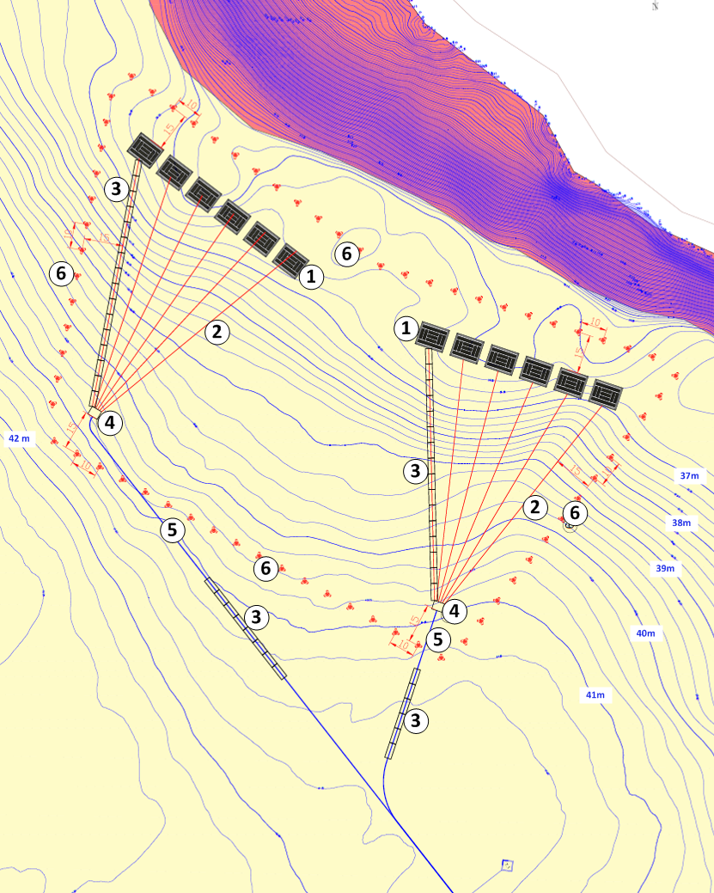
Electrode Plan
Legend:
1. Fibreglass structures with electrode elements (11.0 x 9.5 m)
2. FG7K cables, 120 mm², for the supply of every structure
3. Cement cable protection
4. Junction joints
5. Medium voltage cable with three 3x400 mm² cores for connection to the
converter station
6. Cement protection (tetrapodes)

Slide 12
In the following presented are calculations method and results of the magnetic field in underground and submarine HVDC cable systems, performed by Study authors for all possible combinations.
National and international regulations, guidelines and recommendations serve to limit the exposure of general population and professionals to harmful effects of electric and magnetic fields. Best known international documents are the guidelines provided by the International Commission on Non-Ionizing Protection – ICNIRP, World Health Organization – WHO, and belonging International Agencies for Research on Cancer – IARC. According to those recommendations, limit levels of EM field effect on exposed population are lower than for the staff who are exposed in their workplaces, although in controlled conditions.
In this Study presented are the values of magnetic induction as a function of distance from Prysmian and Nexans cables, for the stated current 1200A in the following cases:
Bipolar operation of cables
Unipolar operation of cables (single pole) with the return current in electrode cable.
Impact of the electric field on the environment is negligible, since the electric field is formed within the cable which is insulated with the metal sheath.

Slide 13
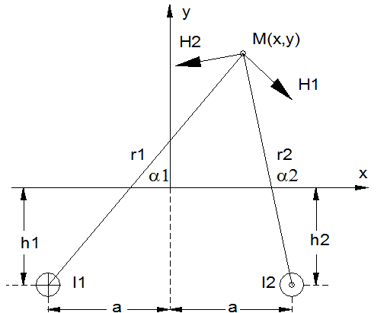
Determining the cables magnetic field
Cable conductors are at h₁ and h₂ depths, and at mutual distance 2a. The origin is adopted on the ground or water surface, on the axis between two cable poles.
Reference current directions are the direction of axis z. Strengths of magnetic field in an arbitrary point M(x,y), which are originated in an individual conductors can be calculated using Biot-Savart principle which out of the conductor follows as:

Slide 14
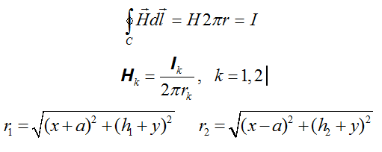
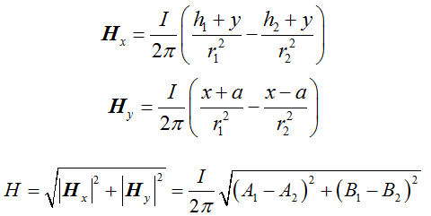
By multiplying fields with sinus or cosine of corresponding angles a₁ and a₂, the horizontal and vertical components of certain conductor fields in the point M(x,y) are obtained, and their summarizing results in the total of horizontal and vertical component of the field:

Slide 15
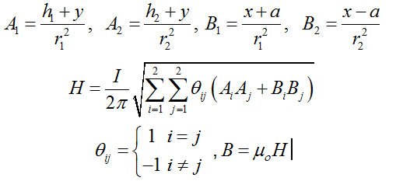
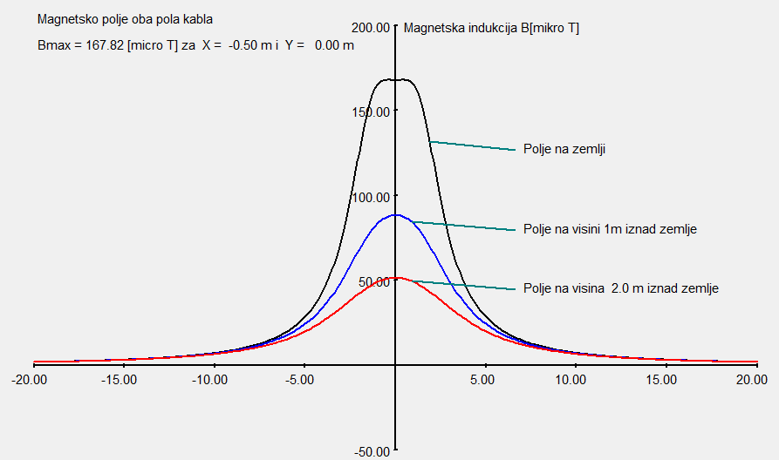
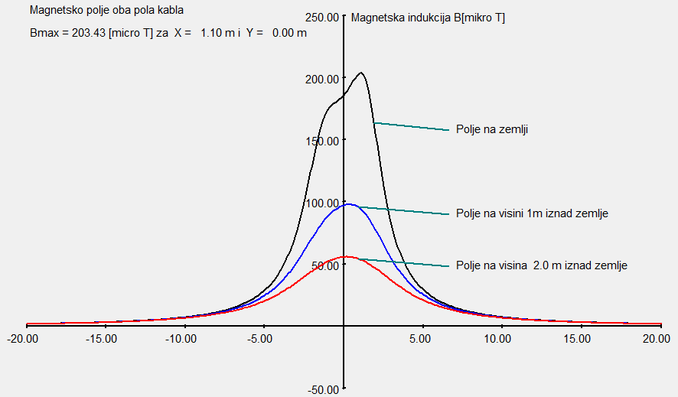
Results of computation for the underground Prysmian cable
Two HVDC pole cables installed in two trenches
Distance between cables: 3 m
Cable burial: h = 1.43 m
Current in the cables: In=1200 A
HVDC pole cable and electrode cable
installed in two separate trenches
Distance between cables: 3 m
Burial of single pole cable: h= 1.43
Burial of electrode cable: 1.13 m

Slide 16
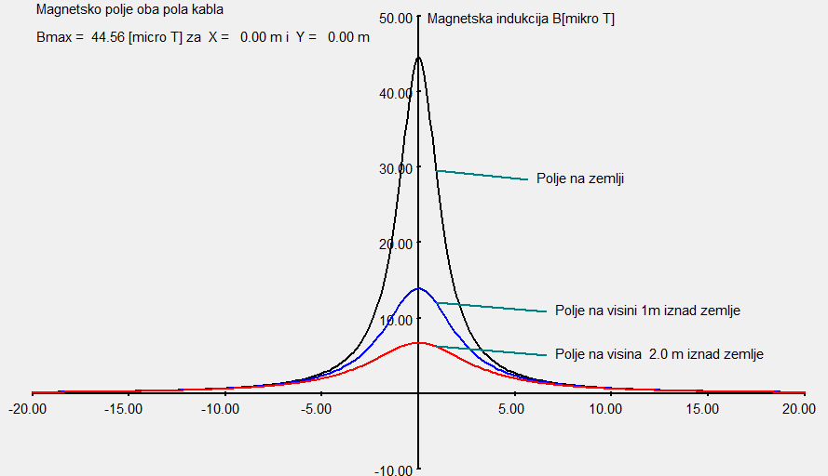
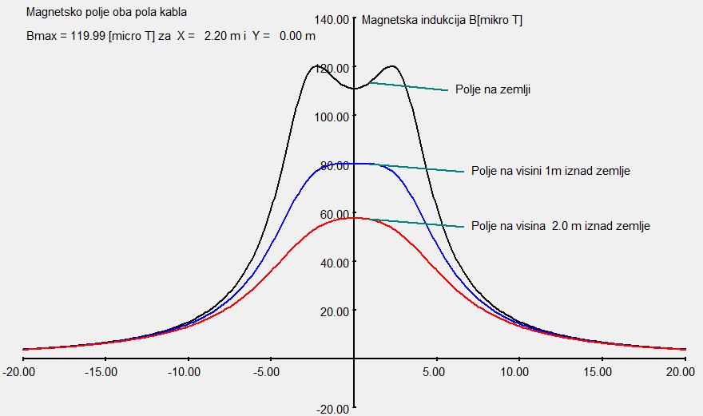
Prysmian cable
HVDC pole cable and electrode cable installed in the same trench
Distance between cables: 0 m Burial of single pole cable: h= 1.43m
Burial of electrode cable: 1.13 m Current through the cables: In=1200A
HVDC pole cables installed in HDD
Distance between cables: 6 m Burial of cables: h=2m
Current through the cables: In=1200A

Slide 17
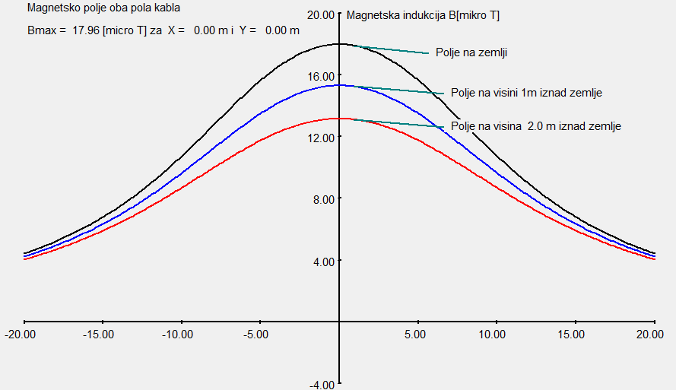
Prysmian cable in HDD
Two HVDC pole cables in HDD
Distance between cables: 9m Burial of cables: h=10m
Current through the cables: In=1200A

Slide 18
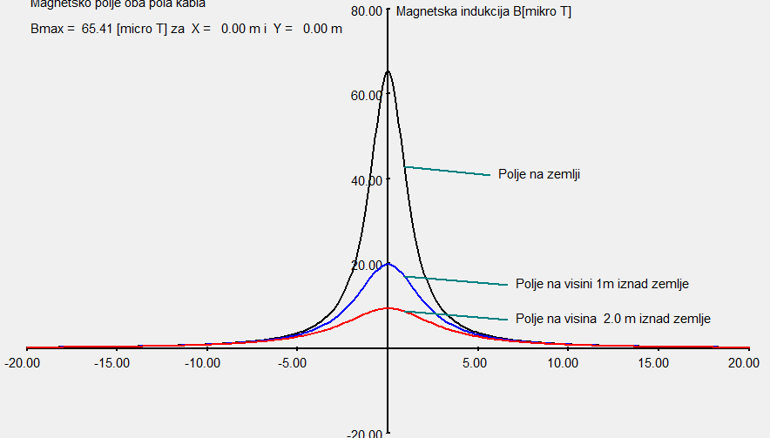
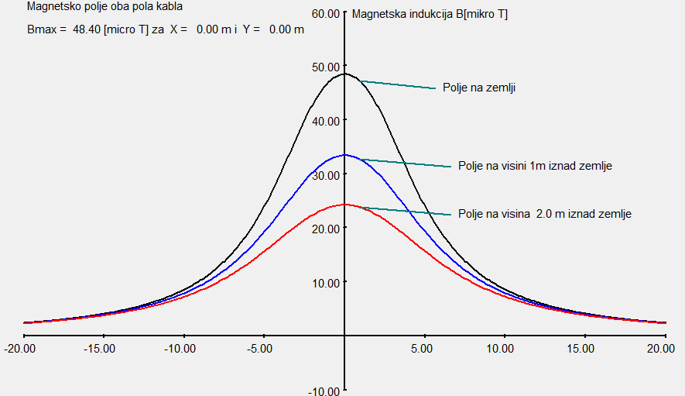
Results of magnetic field calculations for underground cable – NEXANS
Magnetic field of Nexans cables
Spacing between cables: 0.4 m
Burial depth: h=1.2 m
Height above ground: 0, 1 i 2 m
Current: In=1210 A
Cable poles in HDD – Nexans
Spacing between cables: 4 m
Burial depth: h=4 m
Height above ground: 0, 1 i 2 m
Current: In=1210 A

Slide 19
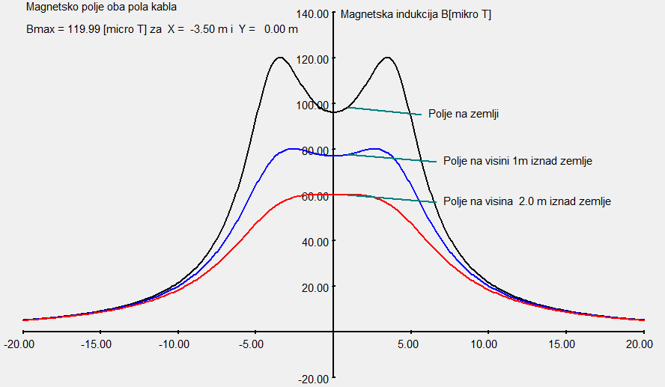
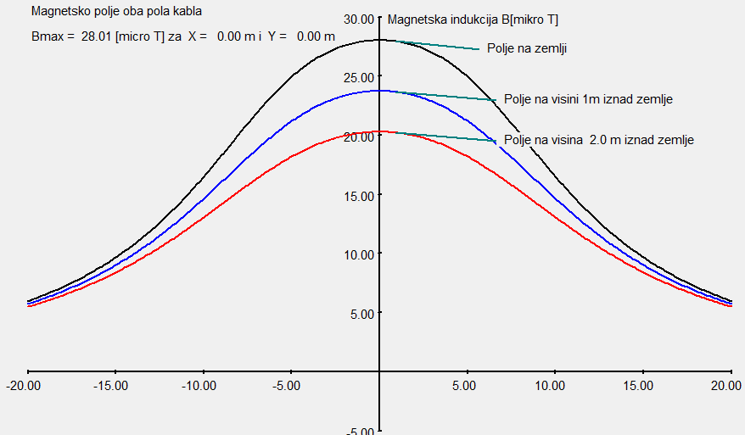
Results of magnetic field calculations for
submarine cable Prysmian
Cables in the pipe at land/sea junction
Spacing between cables: 8 m
Burial depth: h=2 m
Height above ground: 0, 1 i 2 m
Current: In=1200 A
Cables in the pipe at land/sea junction
Spacing between cables: 11m
Burial depth: h=8 m
Height above ground: 0, 1 i 2 m
Current: In=1200 A

Slide 20
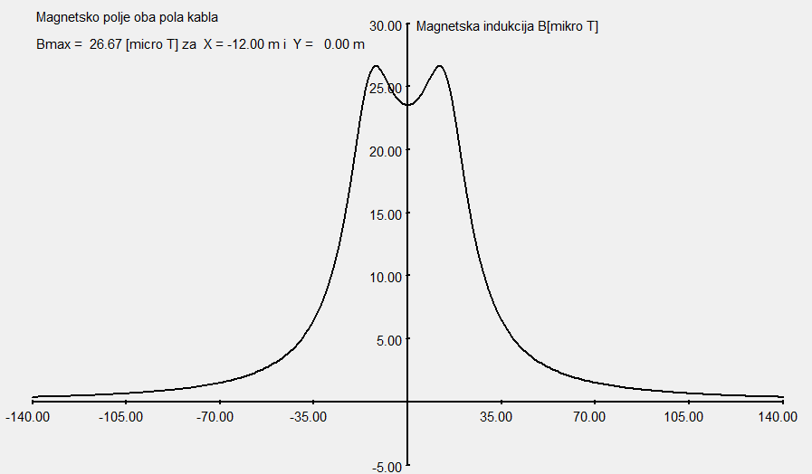
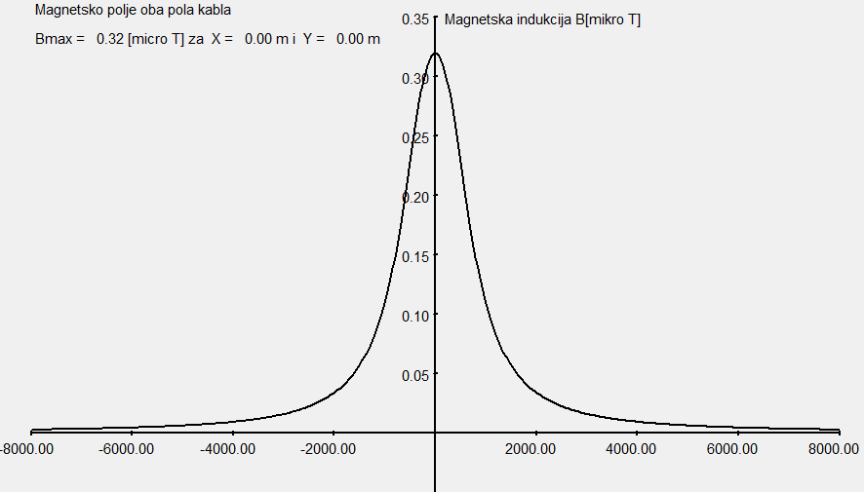
Results of magnetic field calculations for
submarine cable Prysmian
Cables installed in the hole for joint land/sea at the exit from pipe to the sea
Spacing between cables: 30m
Depth of cables: h=8 +1m of burial
Height above water level: 0, 1 i 2 m
Current: In=1200 A
Cables in the sea at 600 m depth
Spacing between cables: 600m
Depth of cables: h=600 +1m of burial
Height above water level: 0 m
Current: In=1200 A

Slide 21
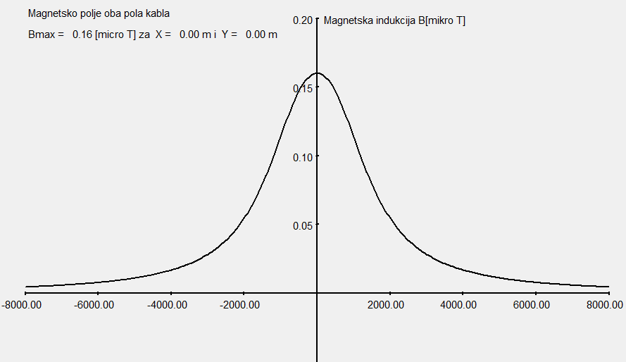
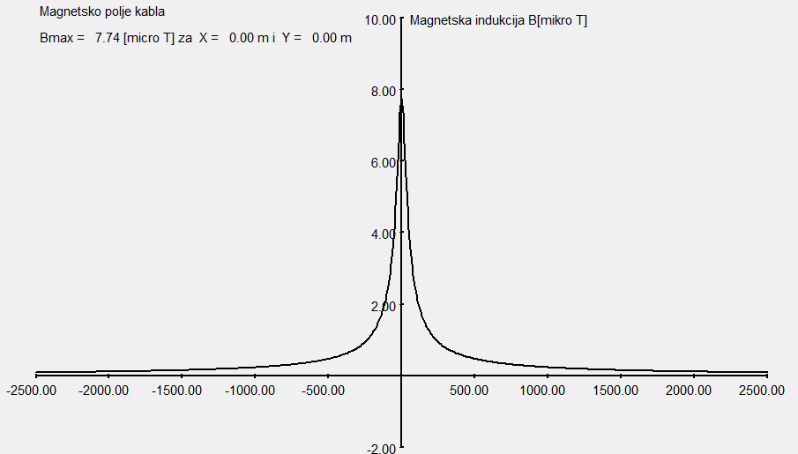
Results of magnetic field calculations for
submarine cable Prysmian
Cables into the sea at 1200 m depth
Spacing between cables: 1200 m
Depth: h=1200 +1m of burial
Height above water level: 0 m
Current: In=1200 A
Electrode cables installed in the sea
at 30 m depth
Spacing between cables: 1200 m
Depth: h=30 +1m of burial
Height above water level: 0 m
Current: In=1200 A

Slide 22
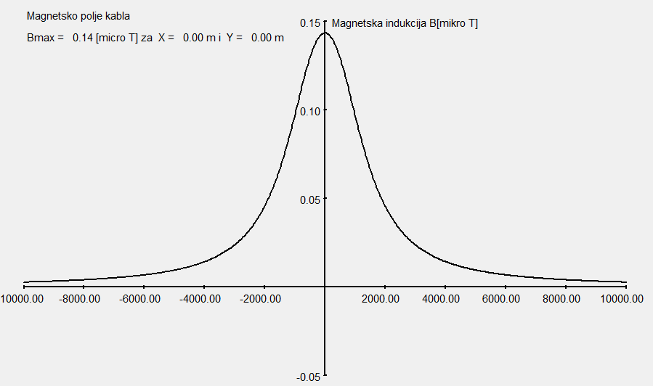
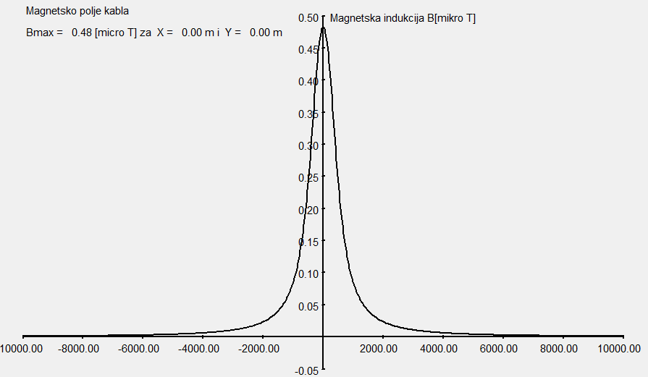
Results of magnetic field calculations for submarine cable – Nexans
Submarine cables into the see - Nexans
Spacing between cables: 1000 m
Depth: h=1200+1m of burial
Height above water level: 0 m
Current: In=1210 A
Submarine cables into the see - Nexans
Spacing between cables: 400 m
Depth: h=400+1m of burial
Height above water level: 0 m
Current: In=1210 A

Slide 23
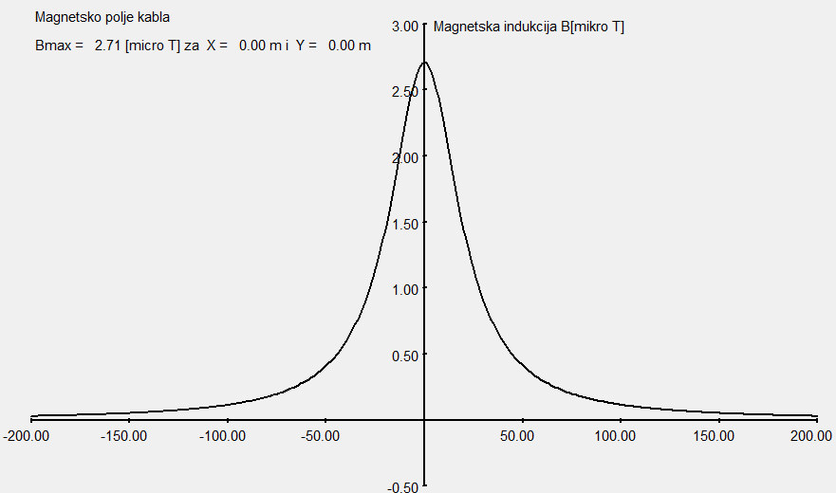
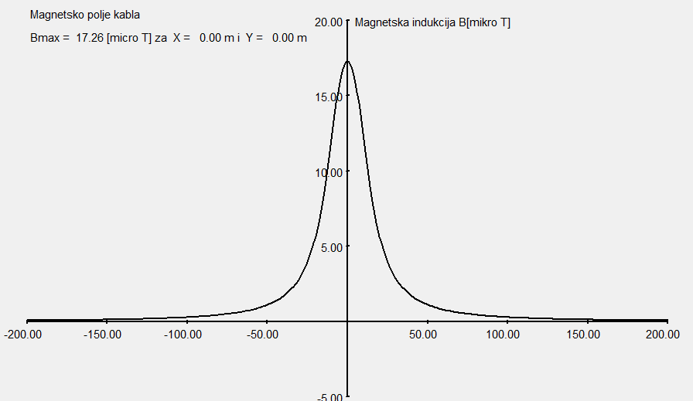
Results of magnetic field calculations for submarine cable – Nexans
Single pole cables installed in the sea (shallow water)
Spacing between cables: 5 m
Cable depth: h=20+1m of burial
Height above water level: 0 m
Current: In=1210 A
Cable poles in HDD
Spacing between cables: 12m
Cable depth: h=10
Height above ground: 1,5 m
Current: In=1210 A

Slide 24
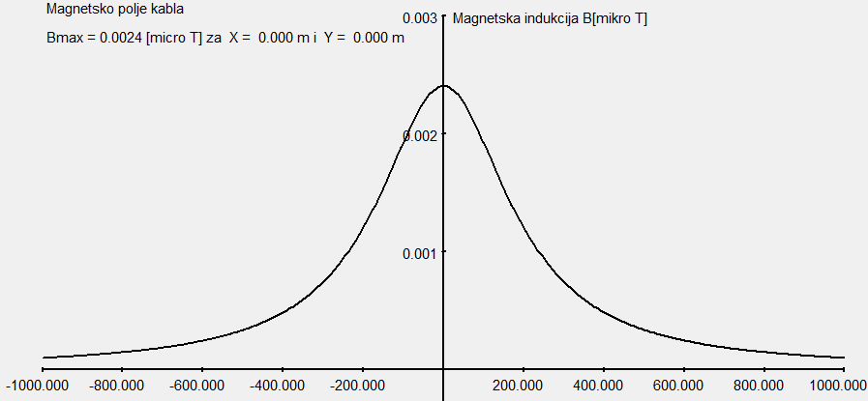
Distribution over sea surface of magnetic field generated by both cable poles with 1200 A per each which are laid at 200 m depth

Slide 25
The magnetic field of the cable - Conclusion
In all analyzed configurations of magnetic flux density (magnetic induction), it is well below the maximum limit of 400 mT recommended by ICNIRP. Therefore, magnetic field of submarine and underground cable cannot cause negative effects on the environment.
In relation to possible impact on compass, the field direction is vertical, so it does not affect the compass that for directions showing uses horizontal component of the Earth’s magnetic field.
Calculations have showed that the horizontal component of the cable magnetic field is always weaker than the total field maximum intensity obtained from the above calculation, and it is a little bit moved from the distance middle between the cable poles.
However, impact on compass depends on the route direction. If a route has east-west direction, as in this case between Montenegro and Italy, the compass is not affected, which makes this case the most favourable. The impact is maximum when the direction of cable route is north-south.
Magnetic field of the cable is static, hence it will not induce the currents in any conductive object.

Slide 26
The magnetic field of the cable - Conclusion
Taking into account magnetic flux density in direct vicinity of submarine cable, and the fact that it significantly decreases with growth of distance from the radiation source, as well as the fact that in the immediate vicinity of the ground part there are no facilities regarded as particularly sensitive areas (such as schools, kindergartens, hospitals, etc.), it can be reliably concluded that in terms of non-ionizing radiation, the requirements, even stricter than those prescribed by ICNIRP, WHO and EU shell be met.
After finishing the works and cable starting, measurements of distribution of magnetic flux density shall be performed on the characteristic locations according to Montenegrin standard MEST EN 50413:2011 which is identical to the European standard EN 50413:2008 "Basic standard on measurement and calculation procedures for human exposure to electric, magnetic and electromagnetic fields (0Hz-300GHz)" and in compliance to the international standard CEI/IEC 61786:1998-08 "Measurement of low-frequency magnetic and electric fields with regards to exposure of human beings - Special requirements for instruments and guidance for measurements".

Slide 27
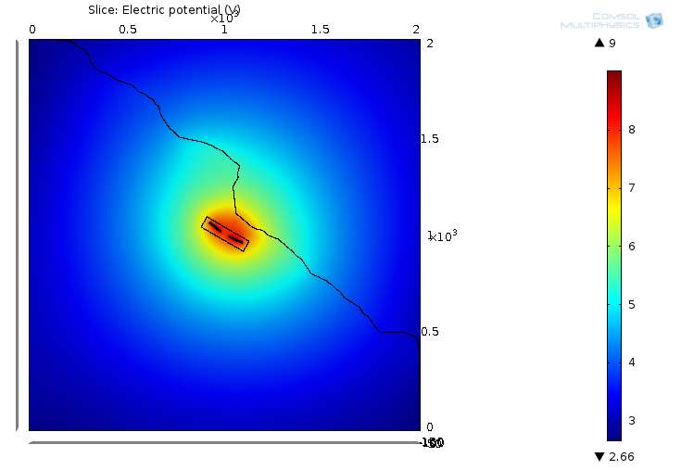
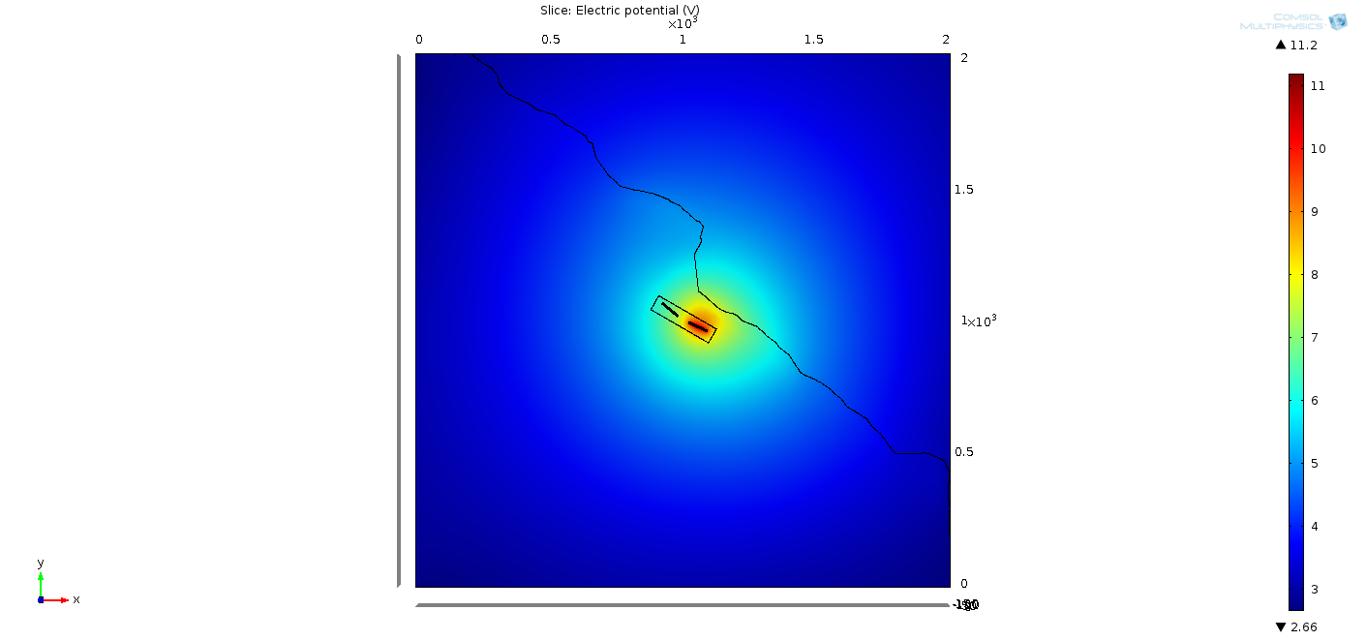
Electrical Effect of Electrode System
The distribution of electrical potential is not perfectly symmetrical due to geographical configuration and rocky shore in the vicinity of the electrode in Montenegro.
In further analysis performed was a simulation on a local three-dimensional model of electrode with the aim of calculating the following:
Distribution of current density on electrode elements
- Electrical field in the vicinity of the electrode
The distribution of electrical potential around the electrode during normal mode of operation (with both sub-electrodes) and extraordinary operating mode, which is viewed as the most critical operating mode and when the operation of the sub-electrode closer to the shore is monitored, was achieved with a finite element method shown in Figures
Normal Operating Mode Extraordinary Operating Mode

Slide 28
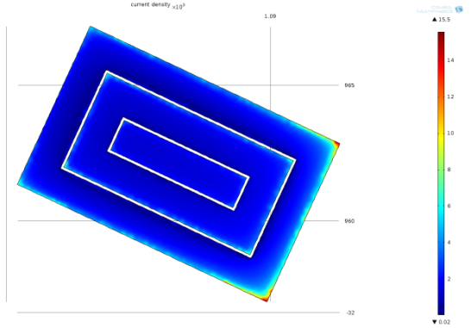
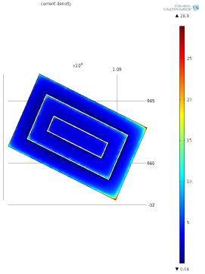
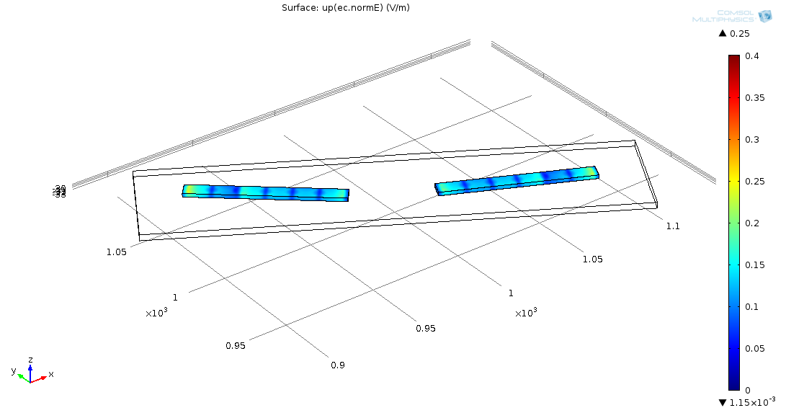
Calculation of the Distribution of Current at the Electrode Element
Normal Operating Mode Extraordinary Operating Mode
Electrical Field at 1m Distance from the Electrode Element
during Normal Operating Mode

Slide 29
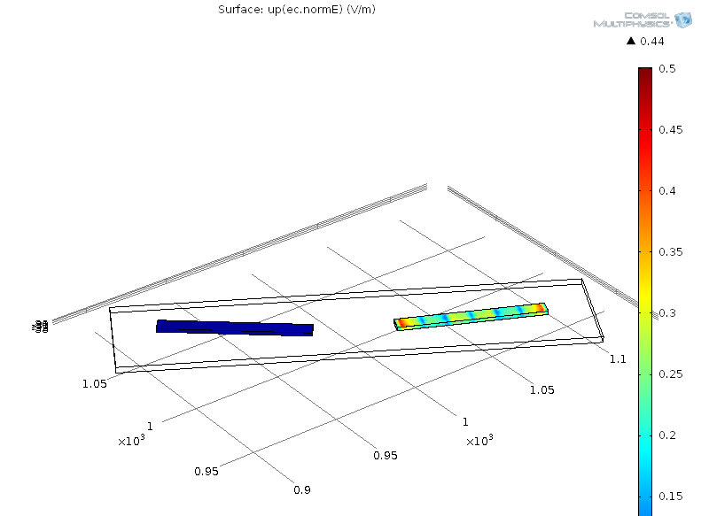
Electrical Field at 1m Distance from the Electrode Element
during Extraordinary Operating Mode
Values of Electric Field Strength
The electric field of the electrode - Conclusion
Total voltage on electrode | Calculated value | Default limit
Normal operation mode: Extraordinary operating mode | 9 V 12 V | 12V 13V
Electric field at 1m from the electrode | Calculated value | Default limit
Normal operating mode: Extraordinary operating mode: | 0.25 V/m 0.45 V/m | 0.4 V/m 0.5 V/m
Electric field at 2m from the electrode | Calculated value | Default limit
Normal operating mode: Extraordinary operating mode: | 0.2 V/m 0.3 V/m | 0.2 V/m 0.3 V/m

Slide 30
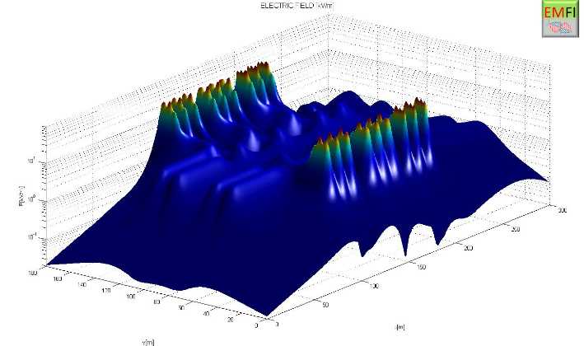
The distribution of the electric field inside the Converter
station near bar bus and AC filters - 1 m above ground

Slide 31
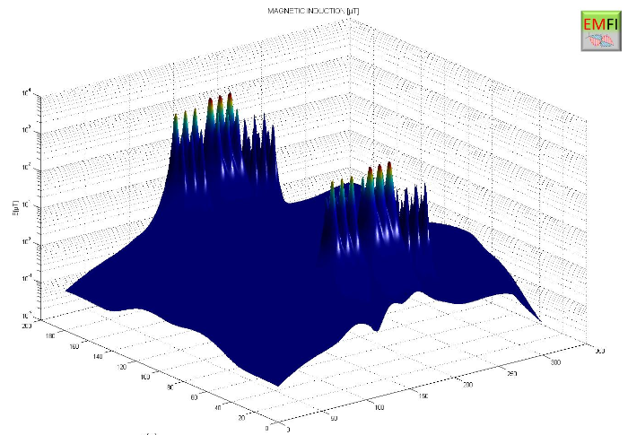
The distribution of the magnetic field inside the Converter
station near bar bus and AC filters - 1 m above ground

Slide 32
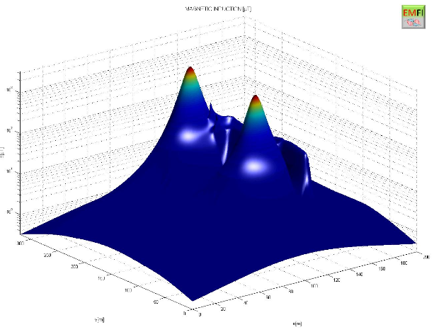
The distribution of the static magnetic field inside the
Converter station - 1 m above ground

Slide 33
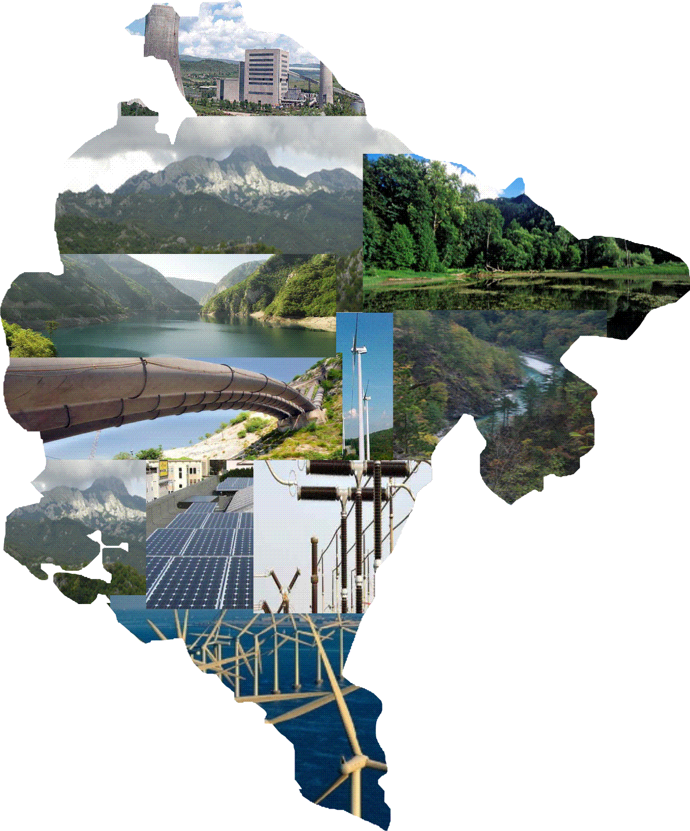
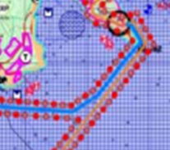
THANK YOU
FOR
THE ATTENTION

